Slide 2

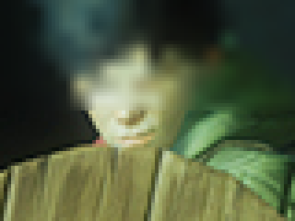






A
B
C
D
E
F
G
H
Original | Resampled
Alpha-Blending | Laplacian
1D-Gaussian | 2D-Gaussian
1D-Gaussian & Alpha-Blending | 2D-Gaussian & Alpha-Blending

